Slide 1


Delegate

Slide 2
Nội dung
– refers to method.
– When initialize a delegate, we initialize it with method.
Example
//Defines a delegate
public delegate int ChangeInt(int x);
public int Tang2(int x){return x + 2;}
public int Giam2(int x) {return x - 2;}
Notes:
delegate: một cái mặt lạ
Tham số chính là một hàm khác

Slide 3
Nội dung
private void btndlg_Click
(object sender, EventArgs e)
{
ChangeInt d = new ChangeInt(Tang2);
MessageBox.Show(d(2)+"");
d = new ChangeInt(Giam2);
MessageBox.Show(d(2)+"");
}

Slide 4
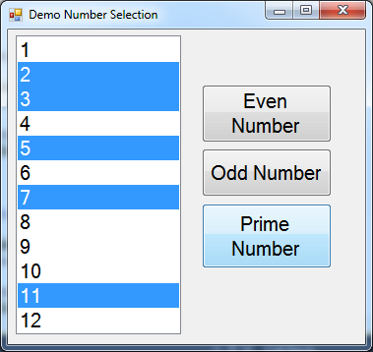
Nội dung
delegate: why?

Slide 5
Nội dung
private void btnEven_Click(object sender, EventArgs e)
{
listNumber.SelectedIndex = -1;
for (int i = 0; i < listNumber.Items.Count; i++)
{
if (Convert.ToInt32(listNumber.Items[i]) % 2 == 0)
listNumber.SelectedIndex = i;
}
}
private void btnOdd_Click(object sender, EventArgs e)
{
listNumber.SelectedIndex = -1;
for (int i = 0; i < listNumber.Items.Count; i++)
{
if (Convert.ToInt32(listNumber.Items[i]) % 2 != 0)
listNumber.SelectedIndex = i;
}
}

Slide 6
Nội dung
private bool isPrime(int x)
{
if (x < 2)
return false;
for (int i = 2; i <= Math.Sqrt(x); i++)
if (x % i == 0)
return false;
return true;
}
private void btnPrime_Click(object sender, EventArgs e)
{
listNumber.SelectedIndex = -1;
for (int i = 0; i < listNumber.Items.Count; i++)
{
int x=Convert.ToInt32(listNumber.Items[i]);
if ( isPrime(x))
listNumber.SelectedIndex = i;
}
}

Slide 7
Nội dung
public static class MyExtensionMethod
{
public delegate bool HandleFunction(int x);
public static void SelectItemInListBox(this ListBox lst,
HandleFunction fn)
{
lst.SelectedIndex = -1;
for (int i = 0; i < lst.Items.Count; i++)
{
int x=Convert.ToInt32(lst.Items[i]);
if (fn(x))
lst.SelectedIndex = i;
}
}
}

Slide 8
Nội dung
private bool isEven(int x)
{
if (x % 2 == 0) return true;
return false;
}
private bool isOdd(int x)
{
if (x % 2 != 0) return true;
return false;
}

Slide 9
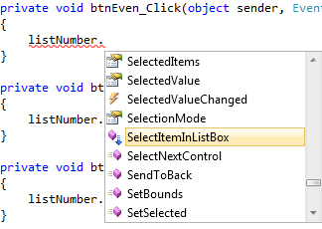
Nội dung
private void btnEven_Click(object sender, EventArgs e)
{listNumber.SelectItemInListBox(isEven);}
private void btnOdd_Click(object sender, EventArgs e)
{listNumber.SelectItemInListBox(isOdd);}
private void btnPrime_Click(object sender, EventArgs e)
{listNumber.SelectItemInListBox(isPrime);}

Slide 10
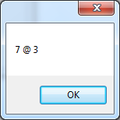
Nội dung
private void button7_Click
(object sender, EventArgs e)
{
ChangeInt d = new ChangeInt(Tang2);
//anonymous method
ChangeInt d1 = delegate(int x)
{
return x - 2;
};
MessageBox.Show(d(5)+" @ "+d1(5));
}

Slide 11
Nội dung
delegate: with anonymous
Exercise:

Slide 12


Hey! Coding is easy!
END

